Slide 1
Programming Machine Learning Applications
Lecture Two: Understanding Characteristics of Data
Dr. Aleksandar Velkoski

Slide 2
Review of Lecture One
Course Overview
Machine Learning
Fundamental Concepts
Getting to Know your Data
Approach to Preparation

Slide 3
Lecture Two
Types of Datasets
Instances & Features
Interactive Workshop

Slide 4
About Datasets

Slide 5
Types of Datasets
Record
Relational records
Data matrix, e.g., numerical matrix, crosstabs
Document data: text documents: term-frequency vector
Transaction data
Graph and network
World Wide Web
Social or information networks
Molecular Structures
Ordered
Video data: sequence of images
Temporal data: time-series
Sequential Data: transaction sequences
Genetic sequence data
Spatial and Multimedia
Spatial data: maps
Image data
Video data

Slide 6
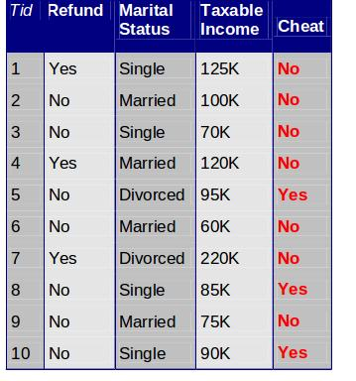
Tabular Data

Slide 7
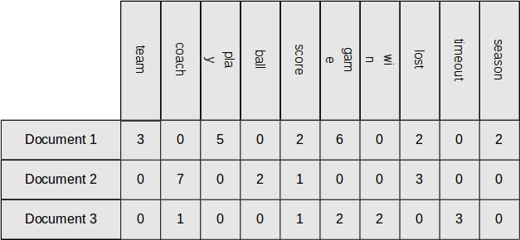
Document Data

Slide 8
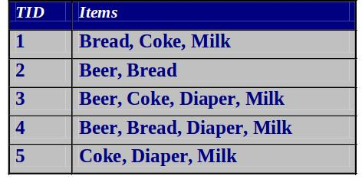
Transaction Data

Slide 9
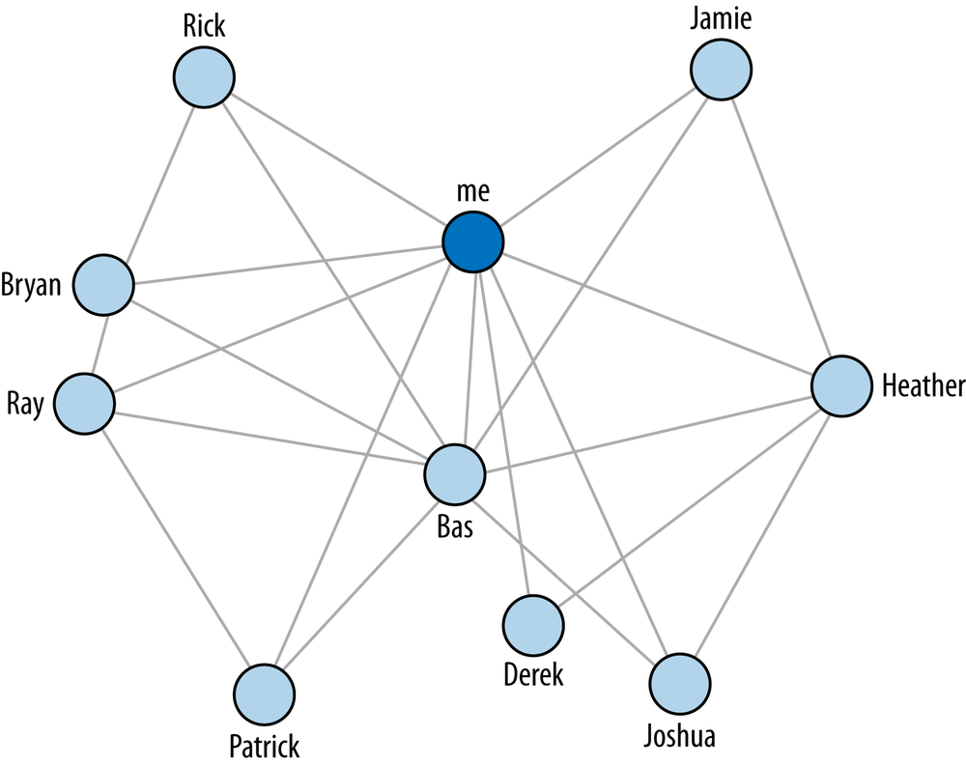
Graph Data

Slide 10
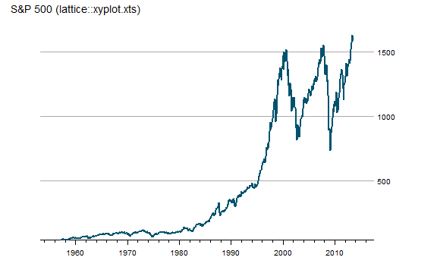
Ordered Data

Slide 11
Instances & Features

Slide 12
Data Instances and Features
Data sets are made up of data instances.
A data instance represents a subject:
sales database: customers, products
medical database: patients, treatments
university database: students, professors, courses
Also called objects (book usage), rows, samples, examples, data points, tuples.
Instances are described by data features: customer _ID, name, address, age

Slide 13
Data Instances and Features
Nominal / Categorical: categories, states, or “names”
Binary: Symmetric and Asymmetric
Ordinal: Values have a meaningful order (ranking) but magnitude unknown
Numeric: Interval-scaled, Ratio Scaled Quantity

Slide 14
Data Instances and Features
Discrete Features
Finite or countably infinite set of values
Continuous
Real numbers as feature values
Usually floating points

Slide 15
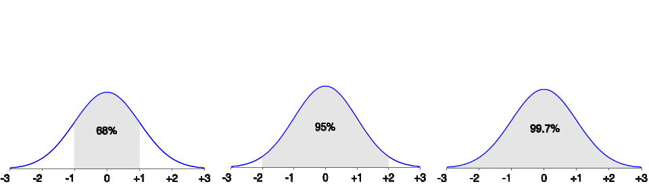
Properties of Distributions
From μ–σ to μ+σ: contains about 68% of the measurements (μ: mean, σ: standard deviation)
From μ–2σ to μ+2σ: contains about 95% of it
From μ–3σ to μ+3σ: contains about 99.7% of it

Slide 16
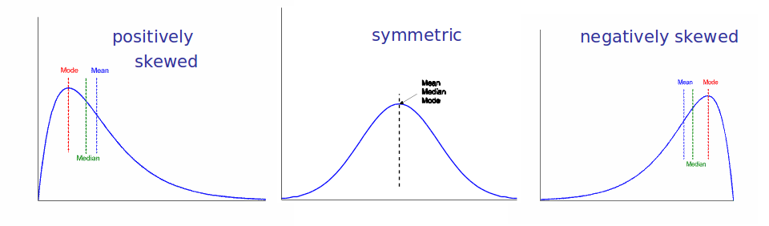
Symmetric vs. Skewed
Median, mean and mode of symmetric, positively and negatively skewed data

Slide 17
Graphic Display of Statistical Descriptions
Boxplot: graphic display of five-number summary
Histogram: x-axis → values; y-axis → frequencies
Quantile plot: plots univariate distribution. each xi is paired with fi indicating that ~ fi *100% of data are xi
Quantile-quantile (q-q) plot: graphs quantiles of one univariate distribution against corresponding quantiles of another.
Scatter plot: each pair of values is a pair of coordinates and plotted as points in the plane

Slide 18
NumPy & Pandas Tutorial

Slide 19
Questions
Wrapping-up the Lecture

Slide 20
What method can you use to get basic statistical descriptions of features in a DataFrame?

Slide 21
How do you create a correlation matrix in Pandas?

Slide 22
What ways can you use to select data in Pandas?

Slide 23
How do you convert a DataFrame to a NumPy Array?

